Slide 1
Knowledge Creation

Slide 2
Group 1
Alex Amoatey ( Group leader)
Jerry
Clifford
Emmanuel
Jonathan
Kwabena jayson

Slide 3
Group 2
Ohene ( Group leader)
Gervin
Benedicta
Kobby
Ernest
Rafiq

Slide 4
Group 3
Herbert( Group leader)
Munike
Caleb
David Mortey
Alex Bamfo
Felix

Slide 5
Group 4
Group 4
Frank( Group leader)
Selorm
Nick
Jones
Donson
Sylvester

Slide 6
Knowledge Workers
Knowledge workers refer to individuals who primarily deal with generating, analyzing, and leveraging knowledge as the core resource of their work.
They possess specialized knowledge, skills, and expertise that enable them to contribute to the creation, acquisition, dissemination, and application of knowledge within an organization or industry.
Examples of knowledge workers include researchers, analysts, scientists, engineers, consultants, and professionals in fields such as information technology, finance, marketing, and human resources

Slide 7
Knowledge Economy
The knowledge economy is a term used to describe an economic system where the generation, dissemination, and utilization of knowledge and information play a central role in driving growth, productivity, and competitiveness.
In a knowledge economy, the production and distribution of goods and services heavily rely on intellectual capital, innovation, and the effective management of knowledge assets.
Knowledge-intensive industries such as technology, healthcare, education, research and development, and creative industries are prominent in the knowledge economy.
Notes:
The key concepts of the knowledge economy is that knowledge and education otherwise
referred as human capital, can be treated as, A business product, as educational and innovation
intellectual products and services can be exported for a high value return and a productive asset.
The key component of knowledge economic is a greater dependence on intellectual capabilities than on physical inputs or natural resources.

Slide 8
Knowledge Economy
In a knowledge economy, the nature of the work in an organization has changed enormously with the shift from an industrial economy where the focus is production of commercial products to a knowledge economy where the main outcomes are service and expertise

Slide 9
Champions
•Champions in knowledge management are individuals who play a critical role in promoting and facilitating knowledge sharing, collaboration, and learning within an organization.
•They are typically enthusiastic advocates for knowledge management initiatives and possess the necessary influence, leadership, and expertise to drive change and encourage others to embrace knowledge-related practices.
•Champions may actively promote the use of knowledge management tools, encourage participation in communities of practice, provide training and guidance, and serve as role models for knowledge sharing behaviors

Slide 10
Knowers
Knowers, also known as subject matter experts (SMEs), are individuals who possess deep knowledge and expertise in specific areas or domains.
They are highly knowledgeable in their respective fields and possess a wealth of tacit knowledge, which is often difficult to articulate or transfer to others.
Knowers are valuable assets within organizations as they hold critical knowledge that may not be readily available in formal documents or databases.
Identifying, engaging, and leveraging the expertise of knowers is crucial for effective knowledge management, as their insights and experience can enhance decision-making, problem-solving, and innovation processes

Slide 11
Knowledge Generation
It is fundamental process in the field of knowledge management. It involves the creation of new knowledge through various activities, such as research, exploration, experimentation, and collaboration.
Knowledge generation refers to the process of acquiring, creating, and integrating new knowledge into an organization or society.

Slide 12
Knowledge update can mean creating new knowledge based on ongoing experience in a specific domain and then using the new knowledge in combination with the existing knowledge to produce updated knowledge for knowledge sharing.
Example:
Knowledge can be created through teamwork A team can commit to perform a job over a specific period.
A job can be regarded as a series of specific tasks carried out in a specific order.
When the job is completed, then the team compares the experience it had initially (while starting the job) to the outcome (successful/disappointing).

Slide 13
This comparison translates experience into knowledge.
While performing the same job in future, the team can take corrective steps and/or modify the actions based on the new knowledge they have acquired.
Over time, experience usually leads to expertise where one team (or individual) can be known for handling a complex problem very well.
This knowledge can be transferred to others in a reusable format.

Slide 14
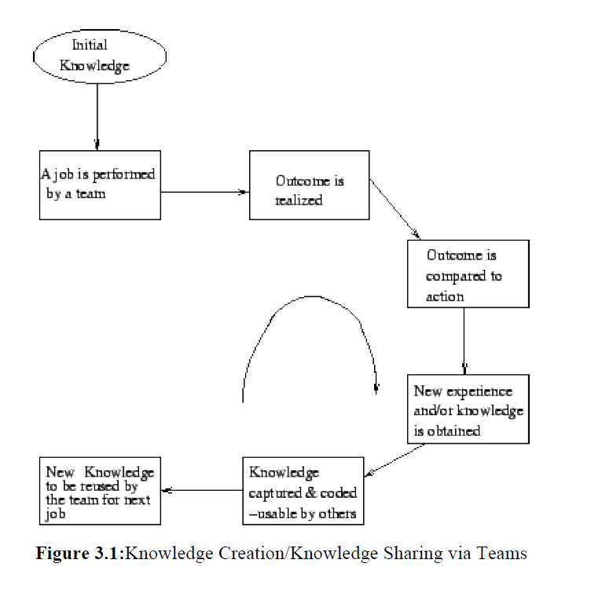

Slide 15
Importance of knowledge generation:
a. Drives innovation and progress: New knowledge enables the development of innovative products, services, and solutions.
b. Enhances competitiveness: Organizations that actively generate new knowledge gain a competitive edge in the market.
c. Supports decision-making: Fresh knowledge empowers individuals and organizations to make informed decisions.

Slide 16
Methods of Knowledge Generation
Research and Development (R&D):
a. Conducting experiments: R&D activities involve designing and conducting experiments to explore new possibilities and test hypotheses.
b. Investigating emerging technologies: Researchers explore cutting-edge technologies to identify their potential applications and limitations.
c. Analyzing existing knowledge: Research includes the analysis and synthesis of existing knowledge to identify gaps and areas for further exploration.

Slide 17
Collaboration and Knowledge Sharing:
a. Brainstorming sessions: Collaborative brainstorming allows individuals to combine their knowledge and generate new ideas collectively.
b. Communities of Practice (CoP): CoPs bring together individuals with shared interests to exchange knowledge, solve problems, and generate new insights.
c. Cross-functional teams: Forming teams with diverse expertise facilitates the generation of multidisciplinary knowledge.

Slide 18
Experimentation and Prototyping:
a. Proof of concept: Developing prototypes and conducting experiments to validate ideas and concepts before implementation.
b. Iterative design: The process of continuous experimentation, evaluation, and refinement to improve the effectiveness and efficiency of a solution.
c. Test environments: Creating controlled environments to simulate real-world scenarios and gather data for analysis and learning.

Slide 19
Nonaka's Model of Knowledge Creation & Transformation
In 1995, Nonaka coined the terms tacit knowledge and explicit knowledge as the two main types of
human knowledge. The key to knowledge creation lies in the way it is mobilized and converted
through technology.
Tacit to tacit communication (Socialization): Takes place between people in meetings or in
team discussions.
Tacit to explicit communication (Externalization): Articulation among people trough dialog (e.g., brainstorming).
Explicit to explicit communication (Combination): This transformation phase can be best supported by technology. Explicit knowledge can be easily captured and then distributed/ transmitted to worldwide audience.
Explicit to tacit communication (Internalization): This implies taking explicit knowledge (e. g., a report) and deducing new ideas or taking constructive action. One significant goal of knowledge management is to create technology to help the users to derive tacit knowledge from explicit knowledge.

Slide 20
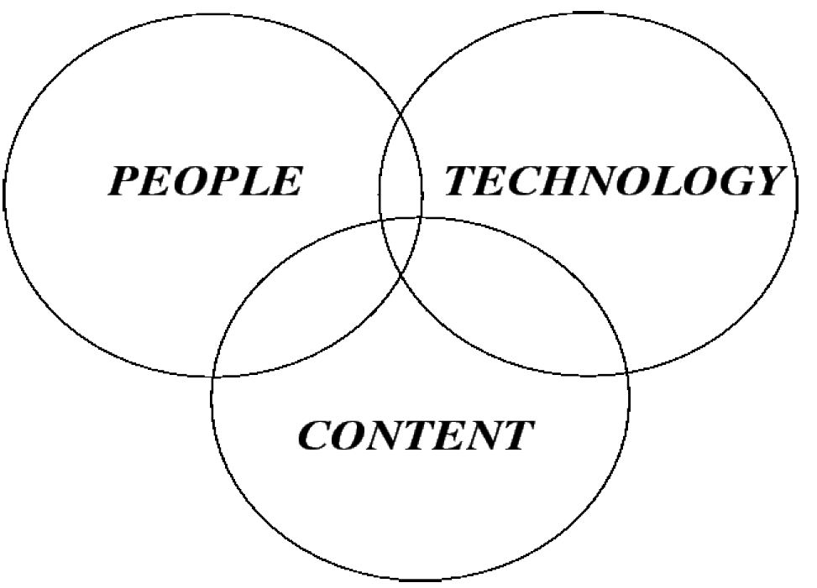
Knowledge Architecture
Knowledge architecture can be regarded as a prerequisite to knowledge sharing.
The infrastructure can be viewed as a combination of people, content, and technology.
These components are inseparable and interdependent as shown below.

Slide 21
The People Core
By people, here we mean knowledge workers, managers, customers, and suppliers.
As the first step in knowledge architecture, our goal is to evaluate the existing information/ documents which are used by people, the applications needed by them, the people they usually contact for solutions, the associates they collaborate with, the official emails they send/receive, and the database(s) they usually access.
All the above stated resources help to create an employee profile, which can later be used as the basis for designing a knowledge management system.
The idea behind assessing the people core is to do a proper job in case of assigning job content to the right person and to make sure that the flow of information that once was obstructed by departments now flows to right people at right time.
In order to expedite knowledge sharing, a knowledge network has to be designed in such a way as to assign people authority and responsibility for specific kinds of knowledge content, which means:

Slide 22
Identifying knowledge centers:
After determining the knowledge that people need, the next step is to find out where the required knowledge resides, and the way to capture it successfully.
Here, the term knowledge center means areas in the organization where knowledge is available for capturing.
These centers supports to identify expert(s) or expert teams in each center who can collaborate in the necessary knowledge capture process.
Activating knowledge content satellites
This step breaks down each knowledge center into some more manageable levels, satellites, or areas.
Assigning experts for each knowledge center:
After the final framework has been decided, one manager should be assigned for each knowledge satellite who will ensure integrity of information content, access, and update.
Ownership is a crucial factor in case of knowledge capture, knowledge transfer, and knowledge implementation.
In a typical organization, departments usually tend to be territorial.

Slide 23
Often, fight can occur over the budget or over the control of sensitive processes (this includes the kind of knowledge a department owns).
These reasons justify the process of assigning department ownership to knowledge content and knowledge process.
adjacent/interdependent departments should be cooperative and ready to share knowledge.

Slide 24
The Technical Core
The objective of the technical core is to enhance communication as well as ensure effective knowledge sharing.
Technology provides a lot of opportunities for managing tacit knowledge in the area of communication.
Communication networks create links between necessary databases.
Here the term technical core is meant to refer to the totality of the required hardware, software, and the specialized human resources.
Expected attributes of technology under the technical core: Accuracy, speed, reliability, security, and integrity.
Since an organization can be thought of as a knowledge network, the goal of knowledge economy is to push employees towards greater efficiency/ productivity by making best possible use of the knowledge they posses.
A knowledge core usually becomes a network of technologies designed to work on top of the organization's existing network.

Slide 25
Layers in the KM Architecture
User Interface Layer
Usually, a web browser represents the interface between the user and the KM system.
It is the top layer in the KM system architecture. It describes how text, graphics, tables etc. are displayed on the screen tends to simplify the technology for the user.
The user interface layer should provide a means for the proper flow of tacit and explicit knowledge.
The necessary knowledge transfer between people and technology involves capturing tacit knowledge from experts, storing it in knowledge base, and making it available to people for solving complex problems.
Features to be considered in case of user interface design:
Consistency
Relevancy
Visual clarity
Usability
Ease of Navigation
Notes:
In our previous lecture, discussing the blue print, we mentioned the layers in the KM Architecture

Slide 26
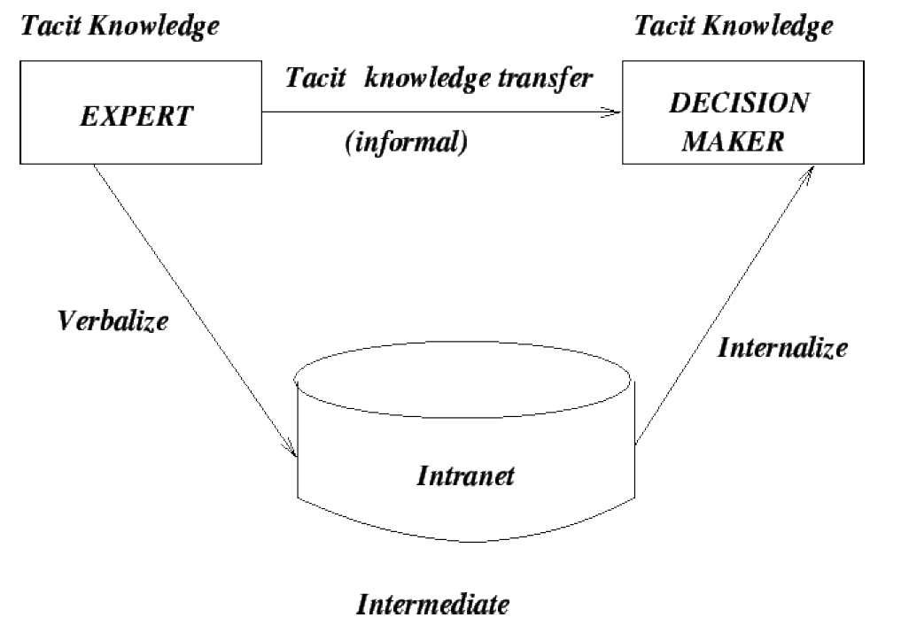
Notes:
In the above diagram, an expert will share some knowledge, gets it captured into a database ( tacit to explicit), A decision maker, reviews shared knowledge in database, makes some deductions from this knowledge (create new knowledge) i.e. internalize-(explicit to tacit)

Slide 27
Authorized Access Layer
This layer maintains security as well as ensures authorized access to the knowledge captured and stored in the organization's repositories.
The knowledge is usually captured by using internet, intranet of extranet.
An organization's intranet represents the internal network of communication systems.
Extranet is a type of intranet with extensions allowing specified people (customers, suppliers, etc.) to access some organizational information. issues related to the access layer: access privileges, backups.
The access layer is mostly focused on security, use of protocols (like passwords), and software tools like firewalls

Slide 28
Firewalls can protect against:
E-mails that can cause problems.
Unauthorized access from the outside world.
Undesirable material (movies, images, music etc).
Unauthorized sensitive information leaving the organization.
Firewalls can not protect against:
Attacks not going through the firewall.
Viruses on external storage media
Weak security policies.

Slide 29
Collaborative Intelligence and Filtering Layer
This layer provides customized views based on stored knowledge.
Authorized users can find information (through a search mechanism) tailored to their needs.
Intelligent agents (active objects which can perceive, reason, and act in a situation to help problem solving) are found to be extremely useful in some situations.
In case of mobile agent computing, the interaction happens between the agent and the server.
A mobile agent roams around the internet across multiple servers looking for the correct information. Some benefits can be found in the areas of:

Slide 30
A mobile agent roams around the internet across multiple servers looking for the correct information. Some benefits can
be found in the areas of: Fault tolerance.
Reduced overall network load.
Heterogeneous operation.
Key components of this layer:
The registration directory that develops tailored information based on user profile.
Membership in specific services, such as sales promotion, news service etc.
The search facility such as a search engine.

Slide 31
In terms of the prerequisites for this layer, the following criteria can be considered:
Security.
Portability.
Flexibility
Scalability
Ease of use.
Integration.

Slide 32
Knowledge-Enabling Application Layer (Value-Added Layer)
This creates a competitive edge.
Most of the applications help users to do their jobs in better ways.
They include knowledge bases, discussion databases, decision support etc.
Transport Layer
This is the most technical layer.
It ensures to make the organization a network of relationships where electronic transfer of knowledge can be considered as routine.
This layer associates with LAN (Local Area Network), WAN (Wide Area Network), intranets, extranets, and internet.
In this layer we consider multimedia, URL's, connectivity speeds/bandwidths, search tools, and consider managing of network traffic.

Slide 33
Middleware Layer
This layer makes it possible to connect between old and new data formats.
It contains a range of programs to do this job.
Repositories Layer
It is the bottom layer of the KM architecture which represents the physical layer in which repositories are installed.
These may include, legacy applications, intelligent data warehouses, operational databases etc.
After establishing the repositories, they are linked to form an integrated repository.

Slide 34
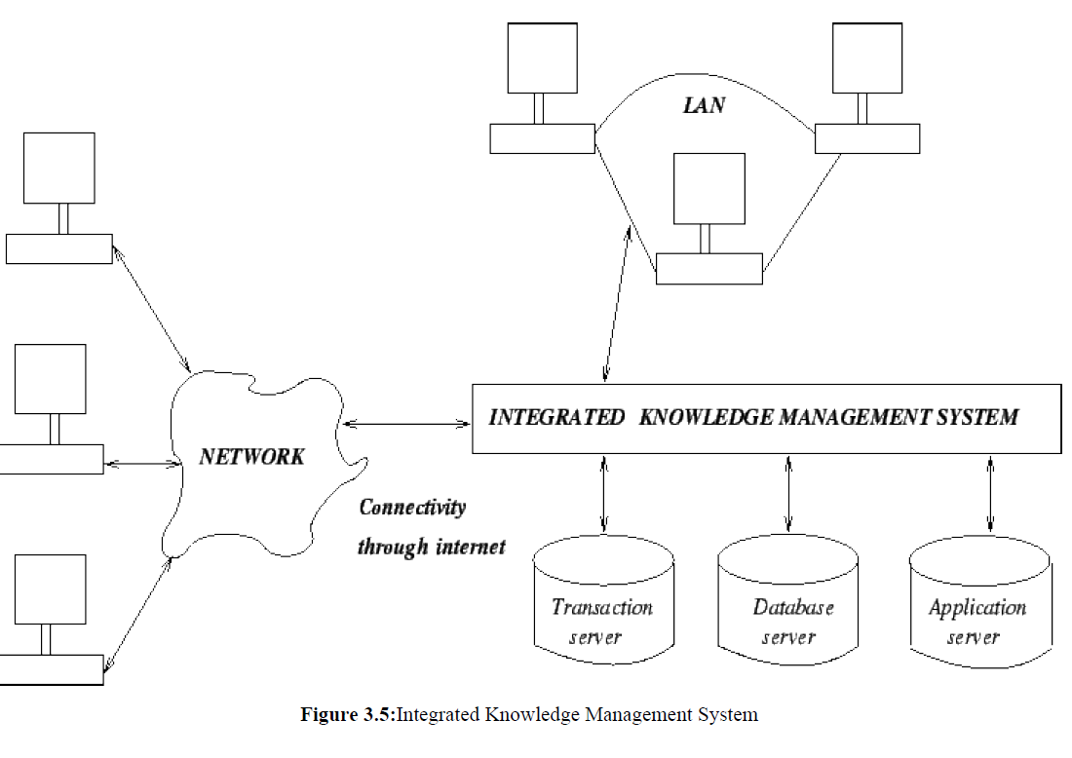

Slide 35
Acquiring the KM System
Building In-house from Scratch
Requires ready professionals.
Development cost is high.
Risk is high.
Main benefit is the customization
Buying
Quick installation.
Low cost.
Customization may not be quite right

Slide 36
Outsourcing
It is a trend that allows organizations to concentrate on their strengths while technological design and other specialized areas are releases to outsiders.
Present trend exists towards ready-to-use, generalized software packages.
Advantages of a reliable KM software package:
Implementation time is shorter.
Development cost is comparatively low.
There exists reduced need of resources.

Slide 37
Advantages of a reliable KM software package Contd.
Offer greater flexibility.
Shorter track record.
Lack of competition.
Application incompatibility.
Crucial components in case of knowledge management systems development:
Reliability
Market pressure.
Usability.
Modularity.
Performance.
Serviceability.
Portability.
Notes:
Buying or outsourcing a KM system raises the important question of ownership. The issues to
consider in case of ownership:
What is the user paying for?
What restrictions exist in case of copying the software for organizational subdivisions?
Who can modify the software and what are the associated costs?
How the modifications can be made if at some stage the vendor happens to be out of business?

Slide 38
Capturing the Tacit Knowledge
Knowledge Capture can be defined as the process by which knowledge is converted from tacit to explicit form (residing within people, artifacts or organizational entities) and vice versa through the sub-processes of externalization and internalization.
In this case, the knowledge developer collaborates with the expert in order to convert the expertise into the necessary program code(s).
Important steps:
Using appropriate tools for eliciting information.
Interpreting the elicited information and consequently inferring the experts underlying knowledge/reasoning process.
Finally, using the interpretation to construct the the necessary rules which can represent the experts reasoning process.
Notes:
Knowledge is available in either explicit(books, manuscripts, reports )or tacit form,

Slide 39
Knowledge Capturing Techniques
On-Site Observation (Action Protocol)
It is a process which involves observing, recording, and interpreting the expert's problem solve process while it takes place.
The knowledge developer does more listening than talking; avoids giving advice and usually does not pass his/her own judgment on what is being observed, even if it seems incorrect; and most of all, does not argue with the expert while the expert is performing the task.
Compared to the process of interviewing, on-site observation brings the knowledge developer closer to the actual steps, techniques, and procedures used by the expert.
One disadvantage is that sometimes some experts to not like the idea of being observed.
The reaction of other people (in the observation setting) can also be a problem causing distraction.
Another disadvantage is the accuracy/completeness of the captured knowledge.
Notes:
In this process, the knowledge developer observes and interprets and record the expert while he or she solves problems, knowledge developer does more listening and observing than asking questions
Best suited for single expert module.

Slide 40
Brainstorming
It is an unstructured approach towards generating ideas about creative solution of a problem which involves multiple experts in a session.
In this case, questions can be raised for clarification, but no evaluations are done at the spot.
Similarities (that emerge through opinions) are usually grouped together logically and evaluated by asking some questions like:
What benefits are to be gained if a particular idea is followed.
What specific problems that idea can possibly solve.
What new problems can arise through this.
The general procedure for conducting a brainstorming session:
Introducing the session.
Presenting the problem to the experts.
Prompting the experts to generate ideas.
Looking for signs of possible convergence.
If the experts are unable to agree on a specific solution, they knowledge developer may callfor vote/consensus.
Notes:
Usually for multiple experts , where they share their ideas and opinions about the solution to a problem, no eveluations are done on the spot

Slide 41
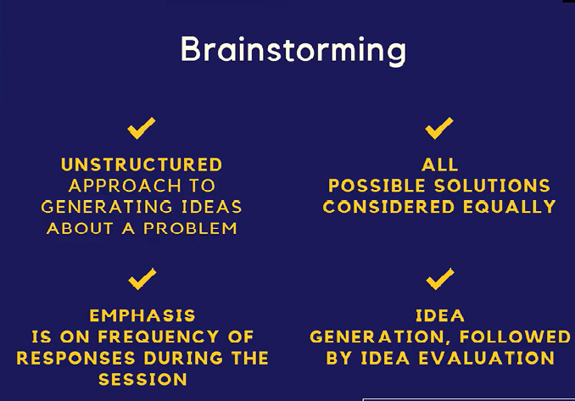

Slide 42
Electronic Brainstorming
Is a computer-aided approach for dealing with multiple experts.
It usually begins with a pre-session plan which identifies objectives and structures the agenda, which is then presented to the experts for approval.
During the session, each expert sits on a PC and get themselves engaged in a predefined approach towards resolving an issue, and then generates ideas.
This allows experts to present their opinions through their PC's without having to wait for their turn.
Usually the comments/suggestions are displayed electronically on a large screen without identifying the source.
This approach protects the introvert experts and prevents tagging comments to individuals.
The benefit includes improved communication, effective discussion regarding sensitive issues, and closes the meeting with concise recommendations for necessary action
This eventually leads to convergence of ideas and helps to set final specifications.
The result is usually the joint ownership of the solution.

Slide 43
Protocol Analysis (Think-Aloud Method)
In this case, protocols (scenarios) are collected by asking experts to solve the specific problem and verbalize their decision process by stating directly what they think.
Knowledge developers do not interrupt in the interim.
The elicited information is structured later when the knowledge developer analyzes the
protocol.
Here the term scenario refers to a detailed and somehow complex sequence of events or more precisely, an episode.
A scenario can involve individuals and objects.
A scenario provides a concrete vision of how some specific human activity can be supported by information technology.
Notes:
In this technique, the knowledge developer ask questions about a problem or scenario, experts are required to give detailed explanation and verbalize the process while solving the problem, or taking a particular decision with reasons

Slide 44
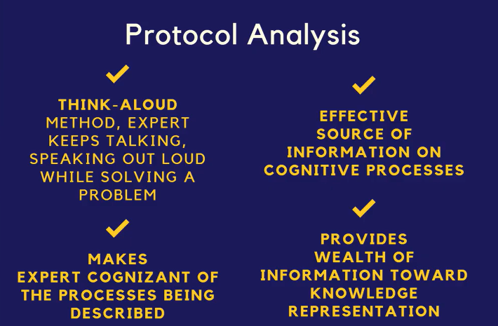

Slide 45
Repertory Grid
This is a tool used for knowledge capture.
The domain expert classifies and categorizes a problem domain using his/her own model.
The grid is used for capturing and evaluating the expert's model.
Two experts (in the same problem domain) may produce distinct sets of personal and subjective results.
The grid is a scale (or a bipolar construct) on which elements can be placed within gradations.
The knowledge developer usually elicits the constructs and then asks the domain expert to provide a set of examples called elements.
Each element is rated according to the constructs which have been provided.
Notes:
The repertory grid is a way of carrying out an interview in a highly structured manner, using the interviewee's own language and setting out their responses in the form of a grid.
A big advantage of the repertory grid technique is that it allows interviewees to articulate their experience in the way they see the world, according to their own personal constructs.
With this technique the knowledge developer frames a scale and experts are asked to fill up the scale, here experts must think properly to ascertain and assign the appropriate values for each element

Slide 46
Consensus Decision Making
Consensus decision making usually follows brainstorming.
It is effective if and only if each expert has been provided with equal and adequate opportunity to present their views.
In order to arrive at a consensus, the knowledge developer conducting the exercise tries to rally the experts towards one or two alternatives.
The knowledge developer follows a procedure designed to ensure fairness and standardization.
This method is democratic in nature.
This method can be sometimes tedious and can take hours.
Notes:
This is similar to brainstorming or more or less a follows after but have a problem or knowledge domain., Each expert in a communication panel will come out with their views or proposals about a specific knowledge domain. Various proposals will be selected and by consensus a final decision or specific solutions or alternatives aer agreed on.

Slide 47
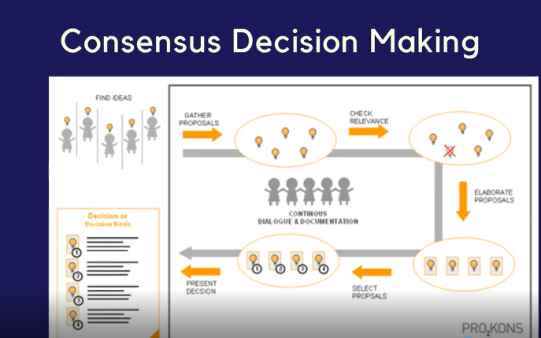

Slide 48
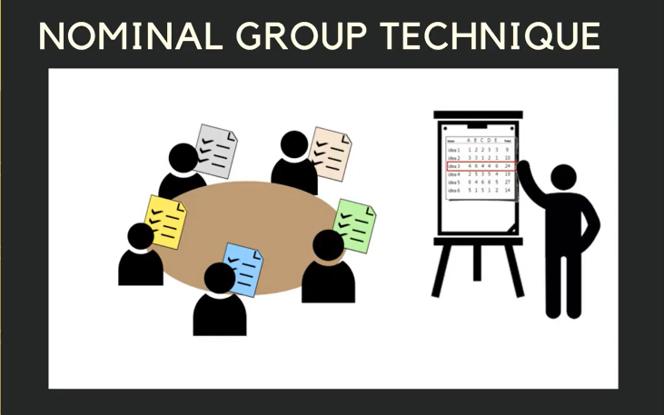
Nominal Group Method
This provides an interface between consensus and brainstorming.
Here the panel of experts becomes a Nominal Group whose meetings are structured in order to effectively pool individual judgment.
Notes:
Example: The knowledge developer posses a problem, each expert is expected to give solutions to the problem. Experts will share their ideas,Then experts will agree on common solutions to the given probelm

Slide 49
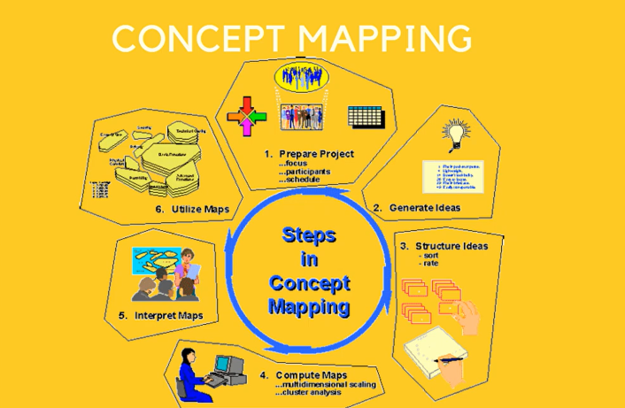

Slide 50
Concept Mapping
It is a network of concepts consisting of nodes and links.
A node represents a concept, and a link represents the relationship between concepts
Concept mapping is designed to transform new concepts/propositions into the existing
cognitive structures related to knowledge capture.
It is a structured conceptualization.
It is an effective way for a group to function without losing their individuality.
Concept mapping can be done for several reasons:
To design complex structures.
To generate ideas.
To communicate ideas.
To diagnose misunderstanding.

Slide 51
Blackboarding
In this case, the experts work together to solve a specific problem using the blackboard as their workspace.
Each expert gets equal opportunity to contribute to the solution via the blackboard.
It is assumed that all participants are experts, but they might have acquired their individual expertise in situations different from those of the other experts in the group.
The process of blackboarding continues till the solution has been reached.
Characteristics of blackboard system:
Diverse approaches to problem-solving.
Common language for interaction.
Efficient storage of information
Flexible representation of information.
Iterative approach to problem-solving.
Organized participation.

Slide 52


Slide 53
Knowledge Codification
Knowledge codification means converting tacit knowledge to explicit knowledge in a usable form for the organizational members.
Tacit knowledge (e.g., human expertise) is identified and leveraged through a form that is able to produce highest return for the business.
Explicit knowledge is organized, categorized, indexed and accessed.
The organizing often includes decision trees, decision tables etc.
Codification must be done in a form/structure which will eventually build the knowledge base.
Notes:
Why Knowledge Codification

Slide 54
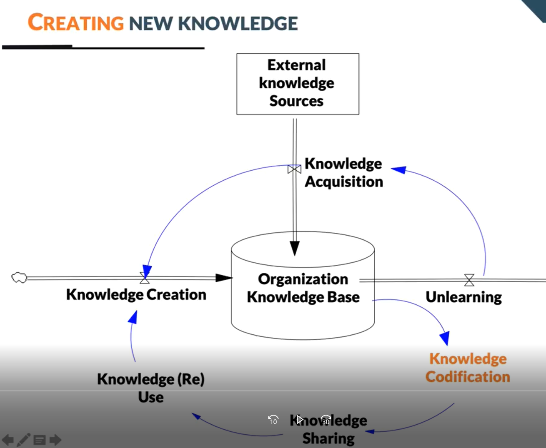

Slide 55
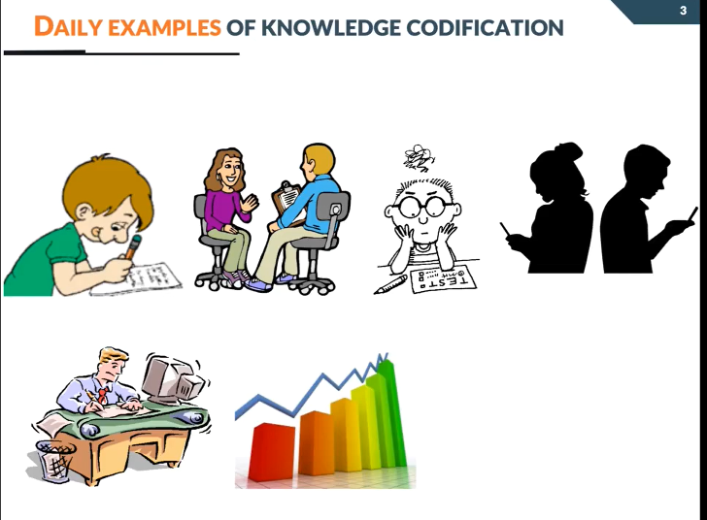
Notes:
Knowledge codification is essential for any knowledge intensive activity
Definition: The process of transferring tacit knowledge to explicit knowledge

Slide 56
The resulting knowledge base supports training and decision making.
Diagnosis.
Training/Instruction.
Interpretation.
Prediction.
Planning/Scheduling

Slide 57
Modes of Knowledge Conversion
Conversion from tacit-to-tacit knowledge produces socialization where knowledge developer looks for experience in case of knowledge capture.
Conversion from tacit to explicit knowledge involves externalizing, explaining or clarifying tacit knowledge via analogies, models, or metaphors.
Conversion from explicit to tacit knowledge involves internalizing (or fitting explicit knowledge to tacit knowledge.
Conversion from explicit-to-explicit knowledge involves combining, categorizing, reorganizing or sorting different bodies of explicit knowledge to lead to new knowledge

Slide 58
Codifying tacit knowledge (in its entirety) in a knowledge base or repository is often difficult because it is usually developed and internalized in the minds of the human experts over a long period of time.
Codification Tools/Procedures
Knowledge Maps
Decision Table
Decision Tree
Frames
Production Rules
Case-Based Reasoning
Knowledge-Based Agents

Slide 59
Codifying Knowledge
Things to Consider before Codification:
What organizational goals will the codified knowledge serve?
What knowledge exists in the organization that can address these goals?
How useful is the existing knowledge for codification?
How would someone codify knowledge
Notes:
Codifying tacit knowledge (in its entirety) in a knowledge base or repository is often difficult
because it is usually developed and internalized in the minds of the human experts over a long
period of time

Slide 60
Aims Of Codification
Reusing in other Contexts i.e.: Applying the knowledge in other similar contexts or scenarios other than the original
Formalization and Standardization
Preventing others from using knowledge
Notes:
Codification helps to formalize and standard knowledge which applies to standards process and procedures to be used in the organization

Slide 61
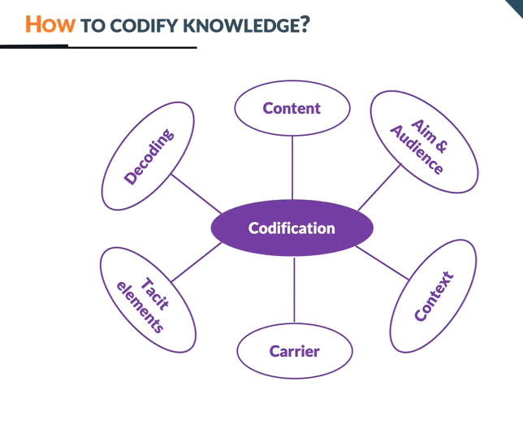
Notes:
Content:
1.Which knowledge domains are critical for codification; organizations should prioritize the critical for the organization.
2. Nature of Knowledge: some knowledge are explicable and can be easily codified: How to do online check-in at the airport, online booking etc, How to create a painting masterpiece like the Monalisa
Aim And Audience: mindful of the potential audience, there is the need for cost benefit analysis to ascertain the cost of codification and benefits of the codification to the organization.
Reading Assignment: Let s read about How Davenport:
Context: What are the incentives or the motivation for the codification process, why should experts avail themselves for the process. What are the power and political gains what, who losses or who gains. What are the daily practices, can codification be part of daily activities.
Carrier: Text, Graphical elements i.e., graphs, tables, chart etc, auidio, software, video etc
Tacit elements: how codified elements is linked with the tacit elements; E.g. Flow chart of assemble a product(encoded), knowing how to read and understand the flow and the abbreviations etc
Decoded: The codified knowledge should be understood by the receivers otherwise it cannot be used. Its necessary you have some knowledge in the knowledge domain

Slide 62
Knowledge Maps
Knowledge maps originated from the belief that people act on things that they understand and accept.
It indicates that self-determined change is sustainable.
Knowledge map is a visual representation of knowledge.
They can represent explicit/tacit, formal/informal, documented/undocumented, internal/external knowledge.
It is not a knowledge repository.
It is a sort of directory that points towards people, documents, and repositories.
It may identify strengths to exploit and missing knowledge gaps to fill.
Knowledge Mapping is very useful when it is required to visualize and explore complex systems

